Slide 1
Consultant Utility Coordination
Project Highlights of Consultant Managed Utility Coordination Efforts
Estill County – KY 89 – Irvine 3-lane
Kevin F. Damron, PE,
Senior Project Manager - Palmer Engineering

Slide 2
Project Initiation
Initial Contacts and Project Assessment
KURTS
Joint Utility Meeting

Slide 3
Project Initiation
Initial Contacts and Project Assessment
Existing Utilities
Identify Items Missing from the Plans

Slide 4
Project Initiation
Initial Contacts & Project Assessment
KURTS
Set Up Project
Prepare and Submit Estimates
Establish Project Schedule

Slide 5
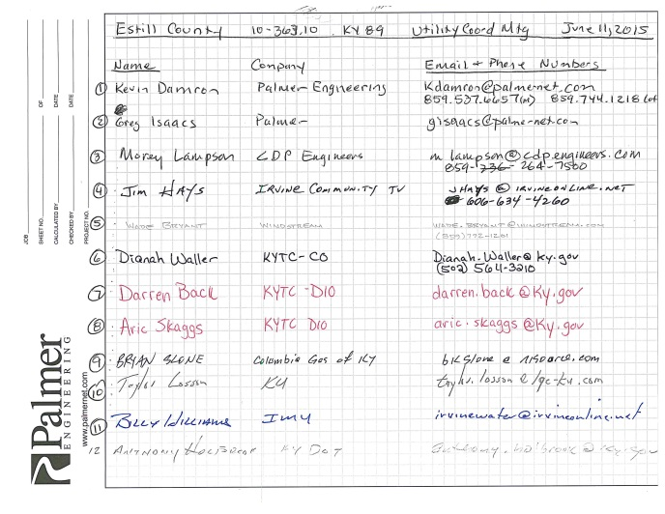
Project Initiation
Initial Contacts and Project Assessment
KURTS
Joint Utility Meeting

Slide 6
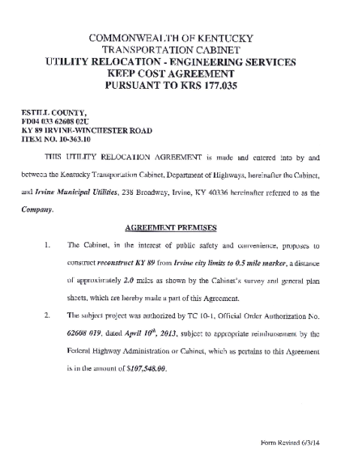
Contract Administration
Coordinate and Prepare Agreements
Review Changes and Prepare Modifications

Slide 7
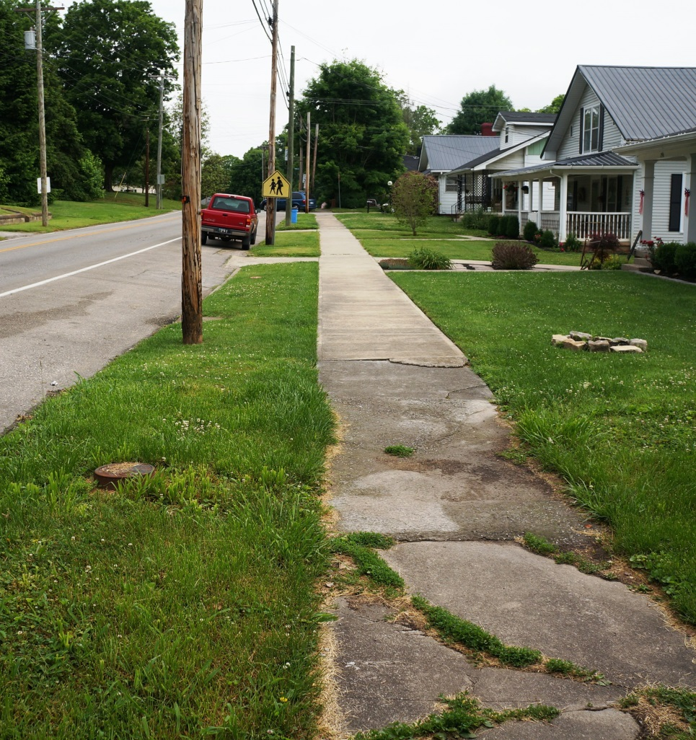
Contract Administration
Coordinate and Prepare Agreements
Review Changes and Prepare Modifications
R/W and Easement Coordination

Slide 8
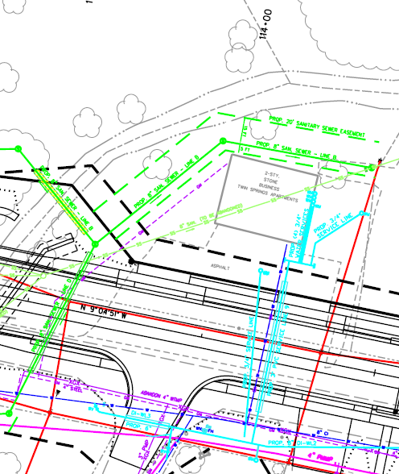
Coordinate and Prepare Agreements
Review Changes and Prepare Modifications
R/W and Easement Coordination
Our Water and Sewer Design Experience also helps us to identify potential betterments
Contract Administration

Slide 9
Develop Utility Relocation Layout Sheet
Contract Administration

Slide 10
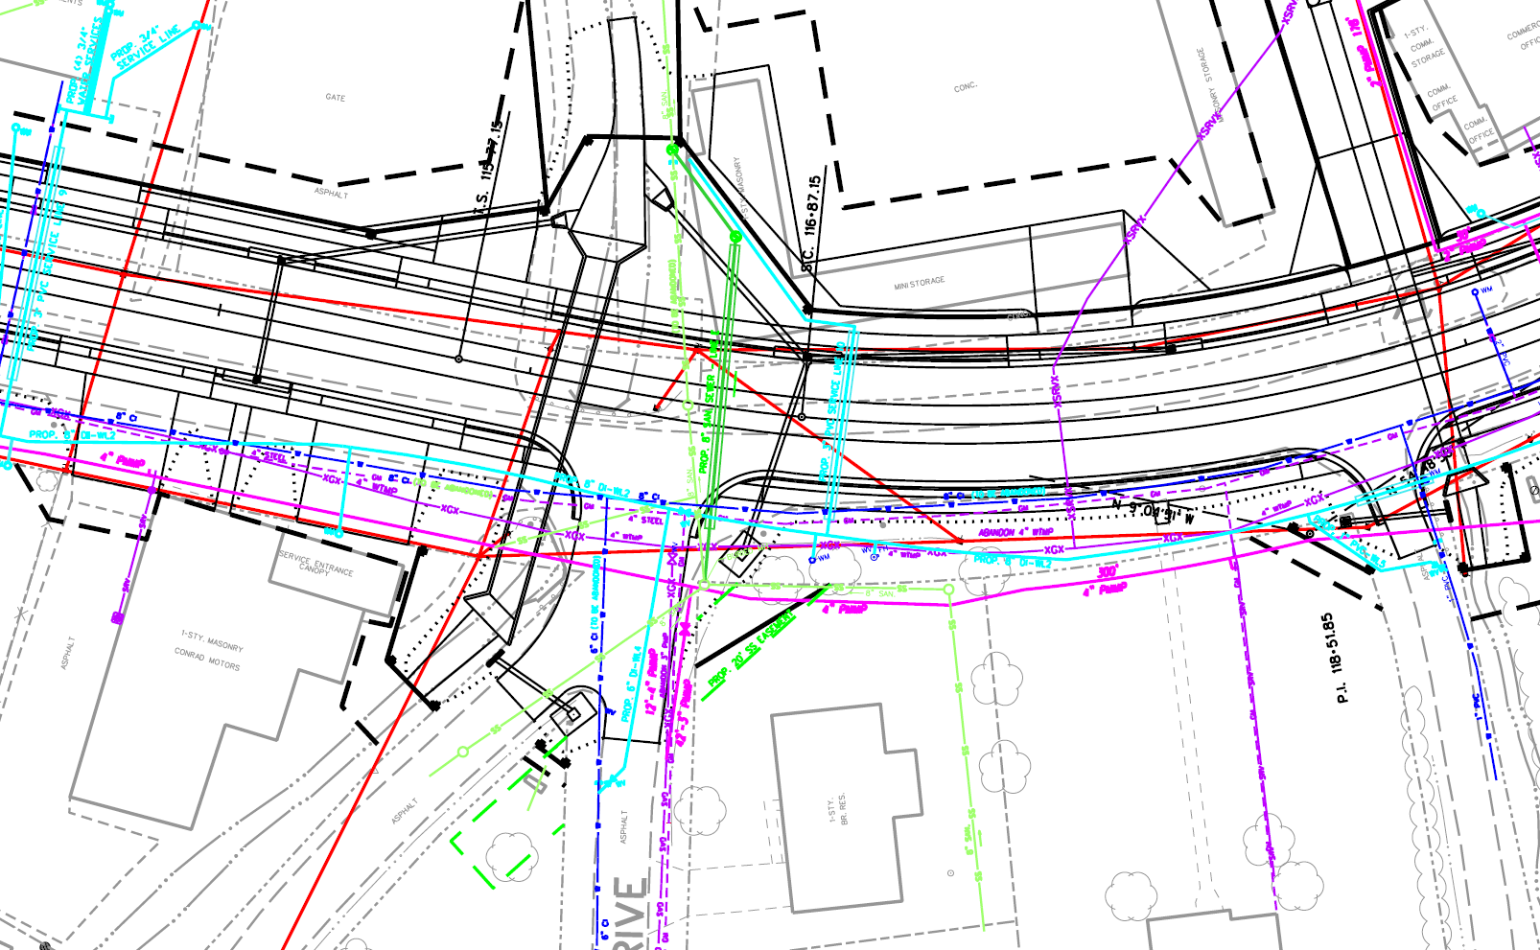
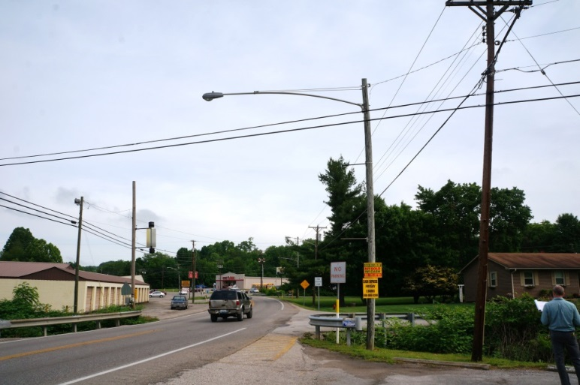
Develop Utility Relocation Layout Sheet
Contract Administration

Slide 11
Progress Meetings and Contacts
Weekly or Bi-weekly phone contacts
Random Meetings
Prepare Monthly Tracking Reports

Slide 12
Progress Meetings and Contacts
Weekly or Bi-weekly phone contacts
Routine Emails and Phone Calls
Exchange Information – FileCloud Site
Aggravate and Pest--Whatever it takes to keep the project on schedule!
Respond to Utility Company Questions and Needs

Slide 13
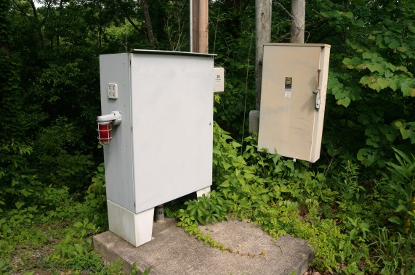
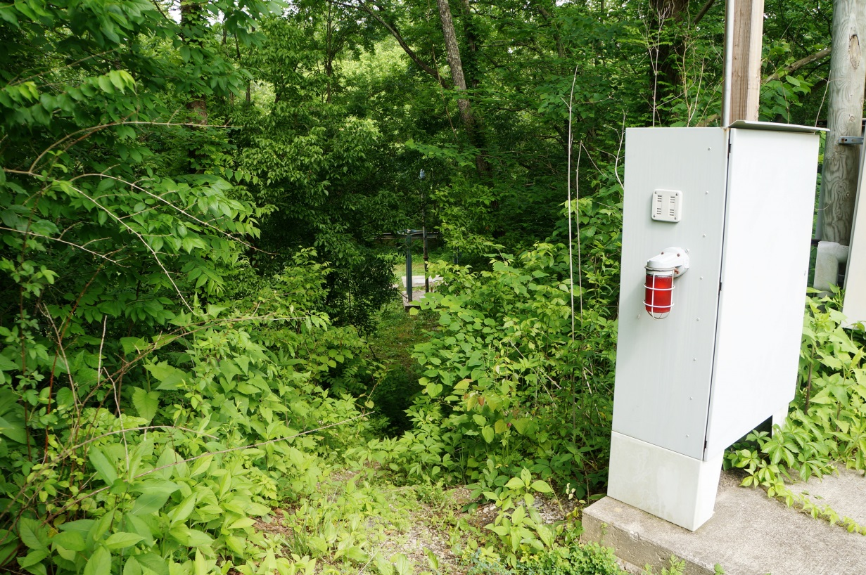
Progress Meetings and Contacts
Respond to Utility Company Questions and Needs
IMU asked if we could avoid the electric box that serves the Sewer Lift Station Lt Sta 139+50?

Slide 14
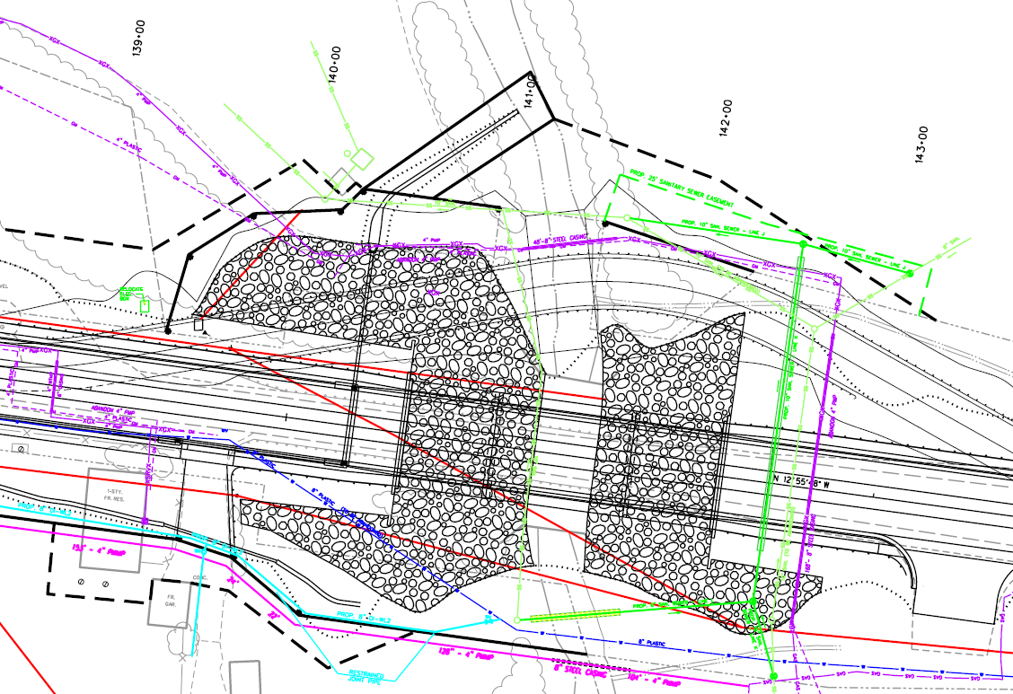
Respond to Utility Company Questions and Needs
IMU asked if we could avoid the electric box that serves the Sewer Lift Station Lt Sta 139+50?
Progress Meetings and Contacts

Slide 15
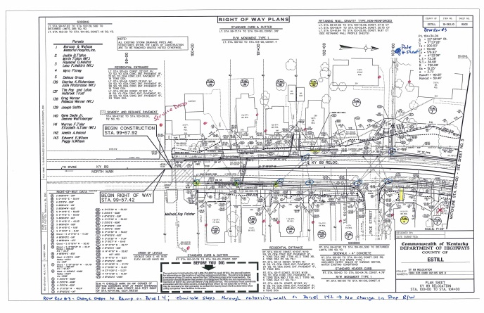
Progress Meetings and Contacts
Random Meetings – Example: Irvine Community TV & Winstream

Slide 16
Progress Meetings & Contacts
Prepare Monthly Tracking Reports

Slide 17
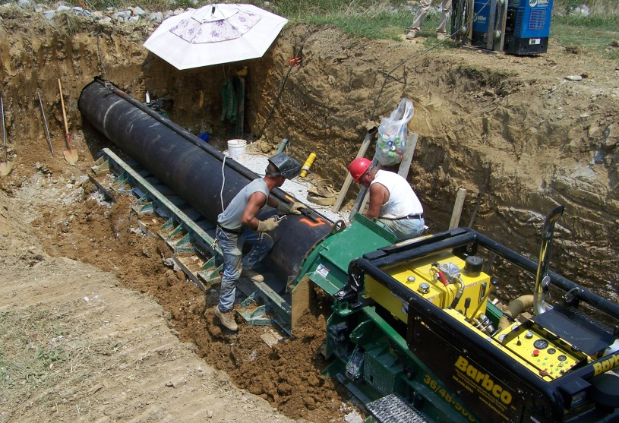
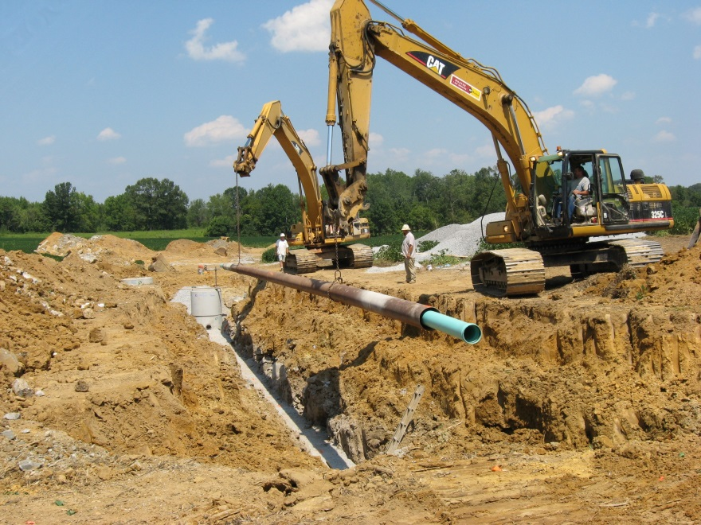
Construction
3 Inspections Per Utility (Additional for Some)

Slide 18
Project Closeouts
Obtain, Review, and Distribute “As-Builts”
Attend Highway Preconstruction Meeting
Coordinate with Highway Construction Contractor

Slide 19
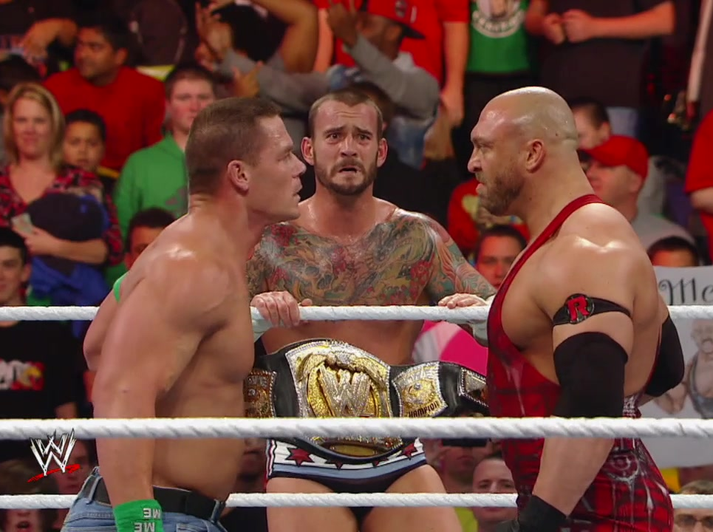
Obtain, Review, and Distribute “As-Builts”
Attend Highway Preconstruction Meeting
Coordinate with Highway Construction Contractor
Project Closeouts

Slide 20
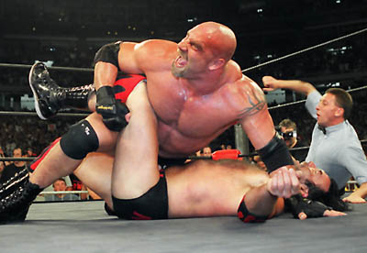
Project Closeouts
Obtain, Review, and Distribute “As-Builts”
Attend Highway Preconstruction Meeting
Coordinate with Highway Construction Contractor

Slide 21
District 1 Utility Design Assignment
Trigg County 1-180.51, US 68
Design Services for Relocation of Lake Barkley State Park Utilities
Water
Sewer
Overhead Electric

Slide 22
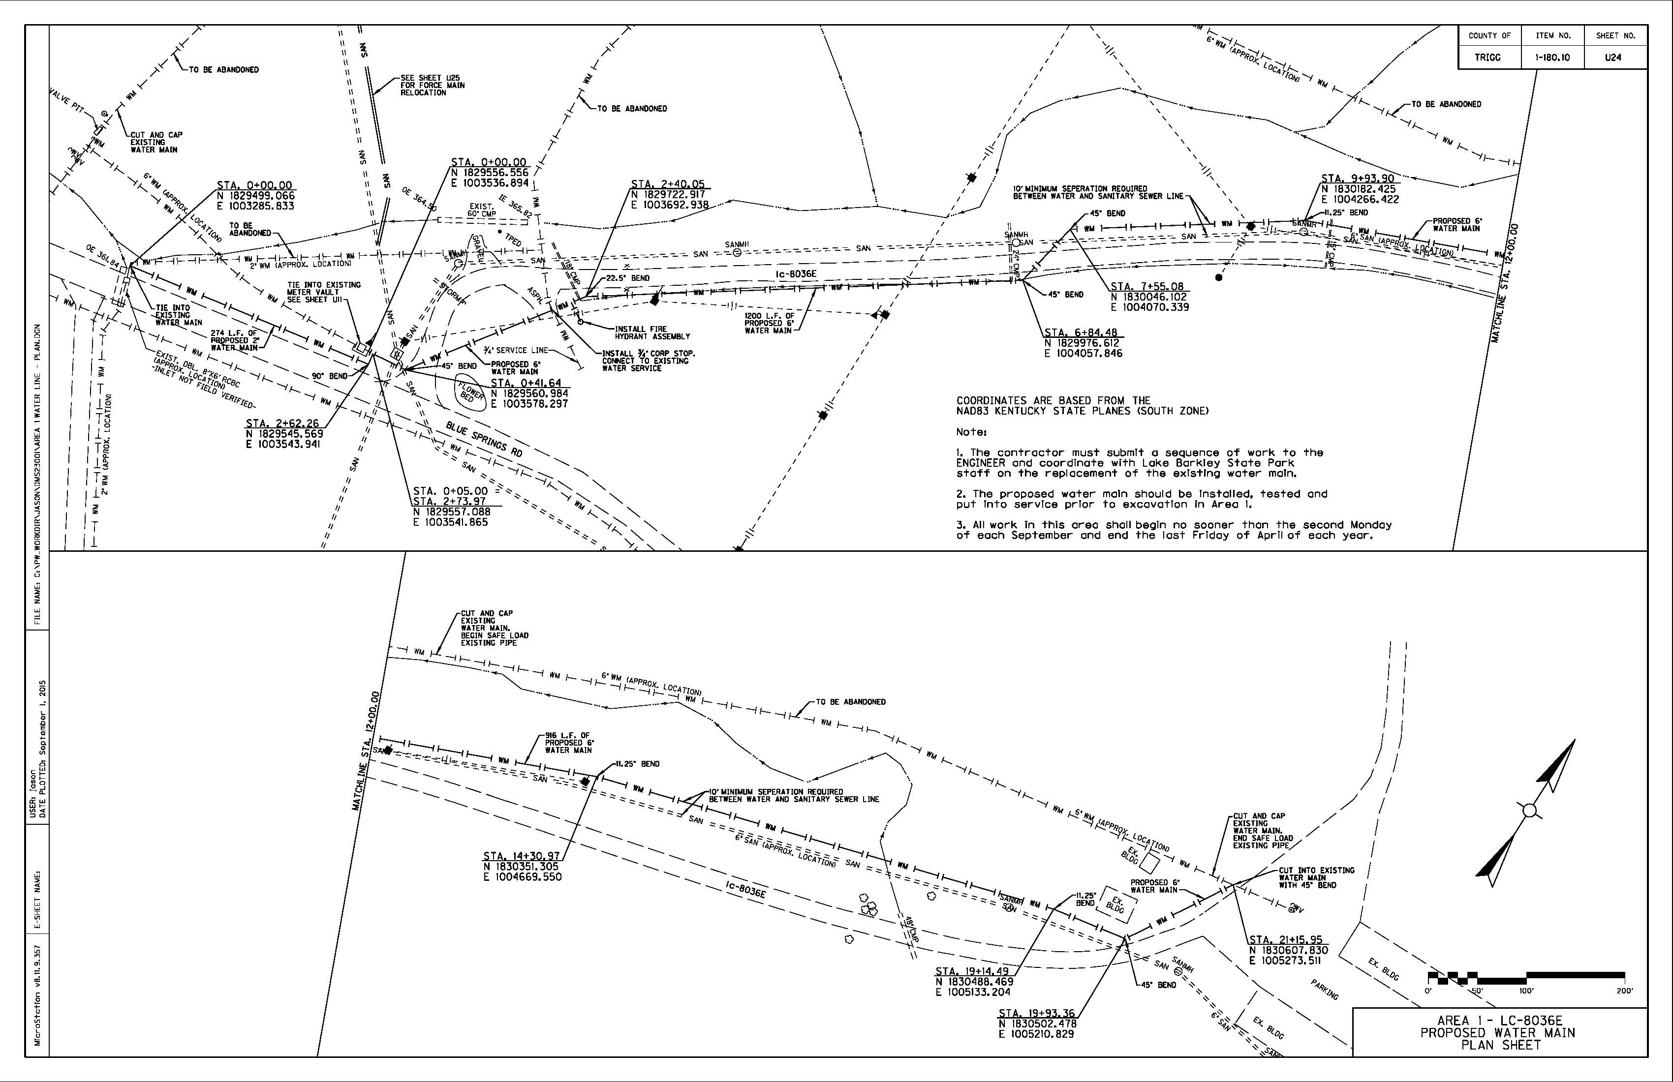
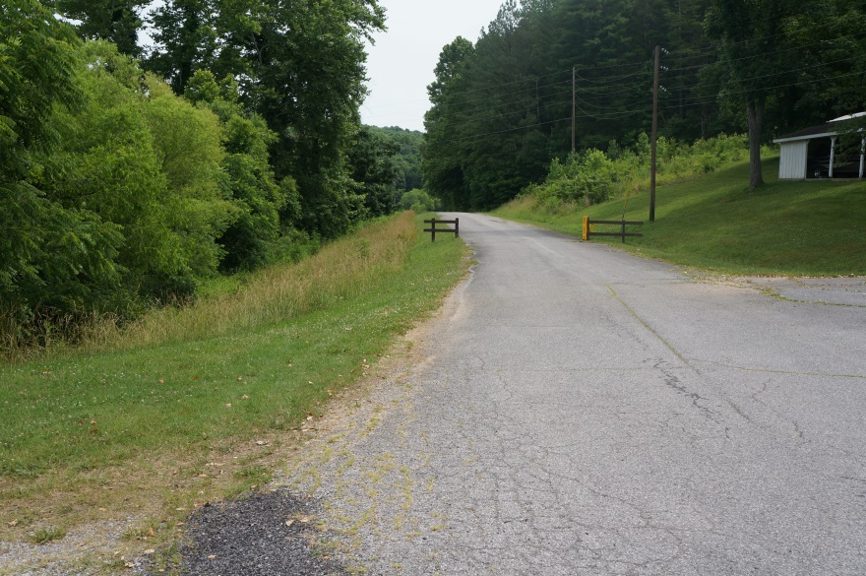
District 1 Utility Design Assignment
Trigg County - Water & Sewer Line Design

Slide 23
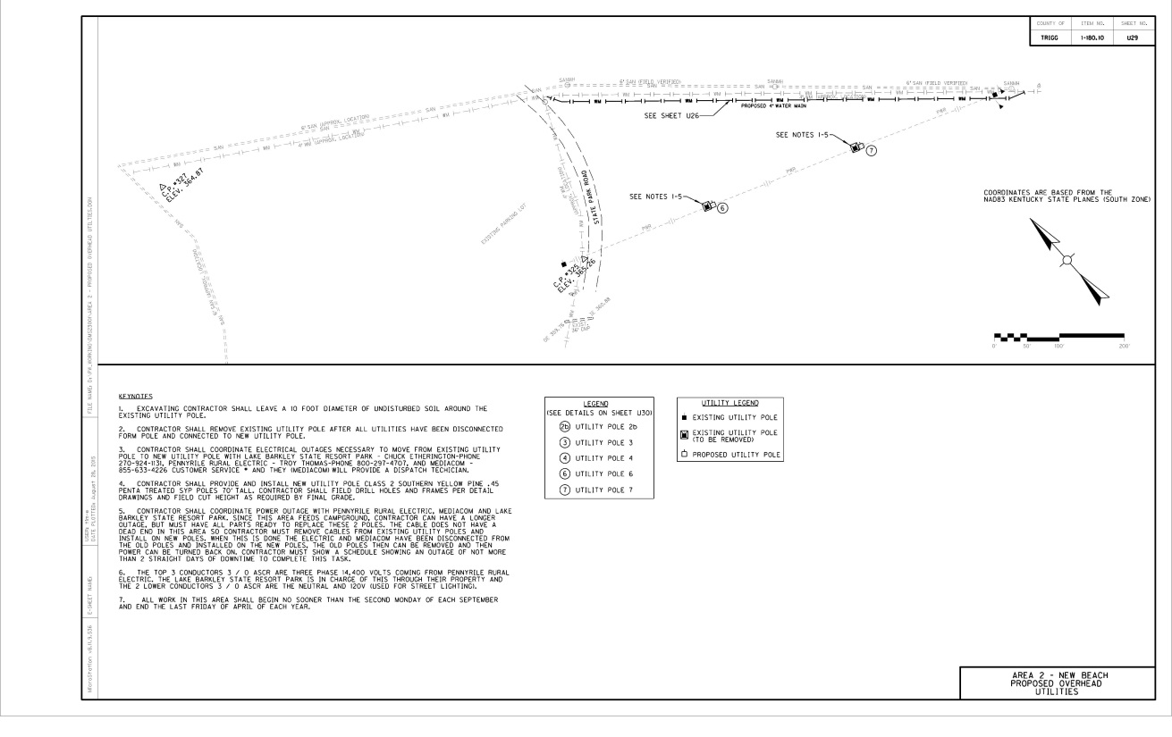
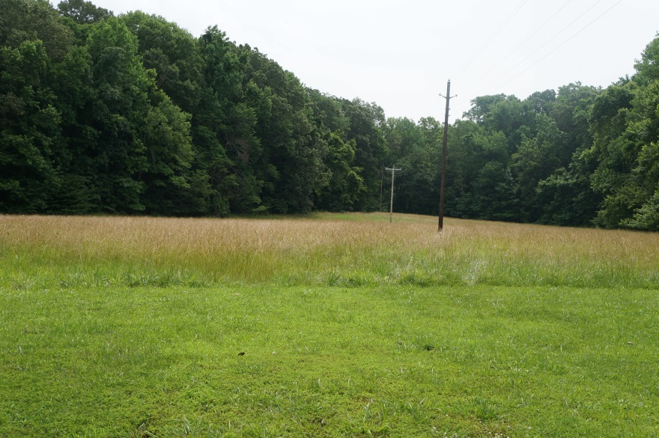
District 1 Utility Design Assignment
Trigg County – Overhead Electric by Magna Engineers

Slide 24
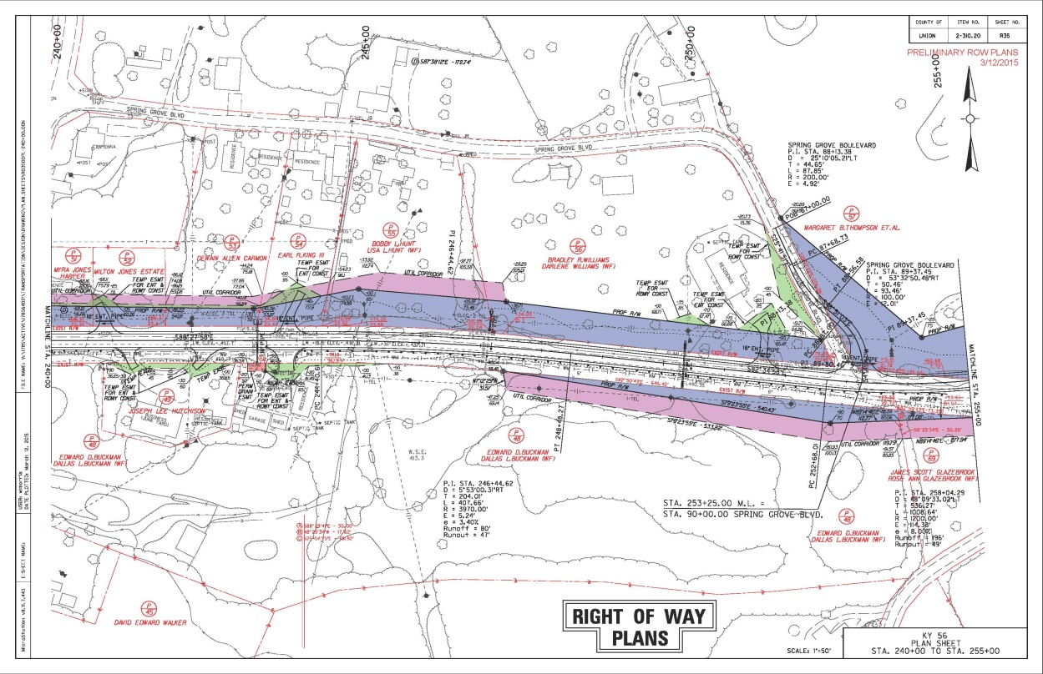
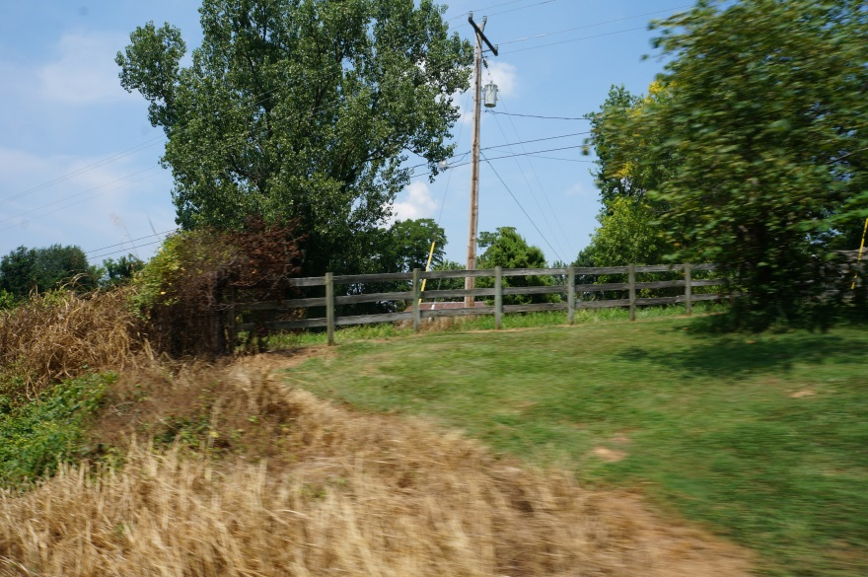
District 2 Utility Coordination Assignment
Union County, 2-310.20 – KY 56 with Stantec

Slide 25
District 12 Utility Coordination Assignment
Floyd County, 12-195
KY 979 – Spot Improvements to John M. Stumbo School

Slide 26
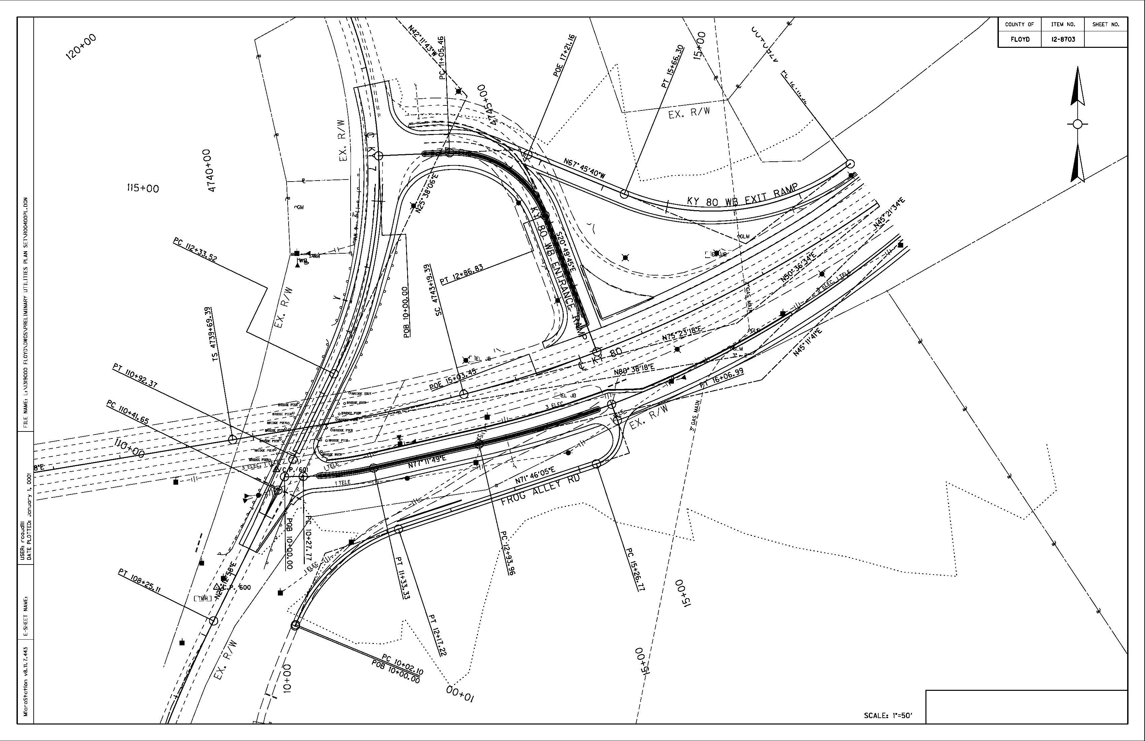
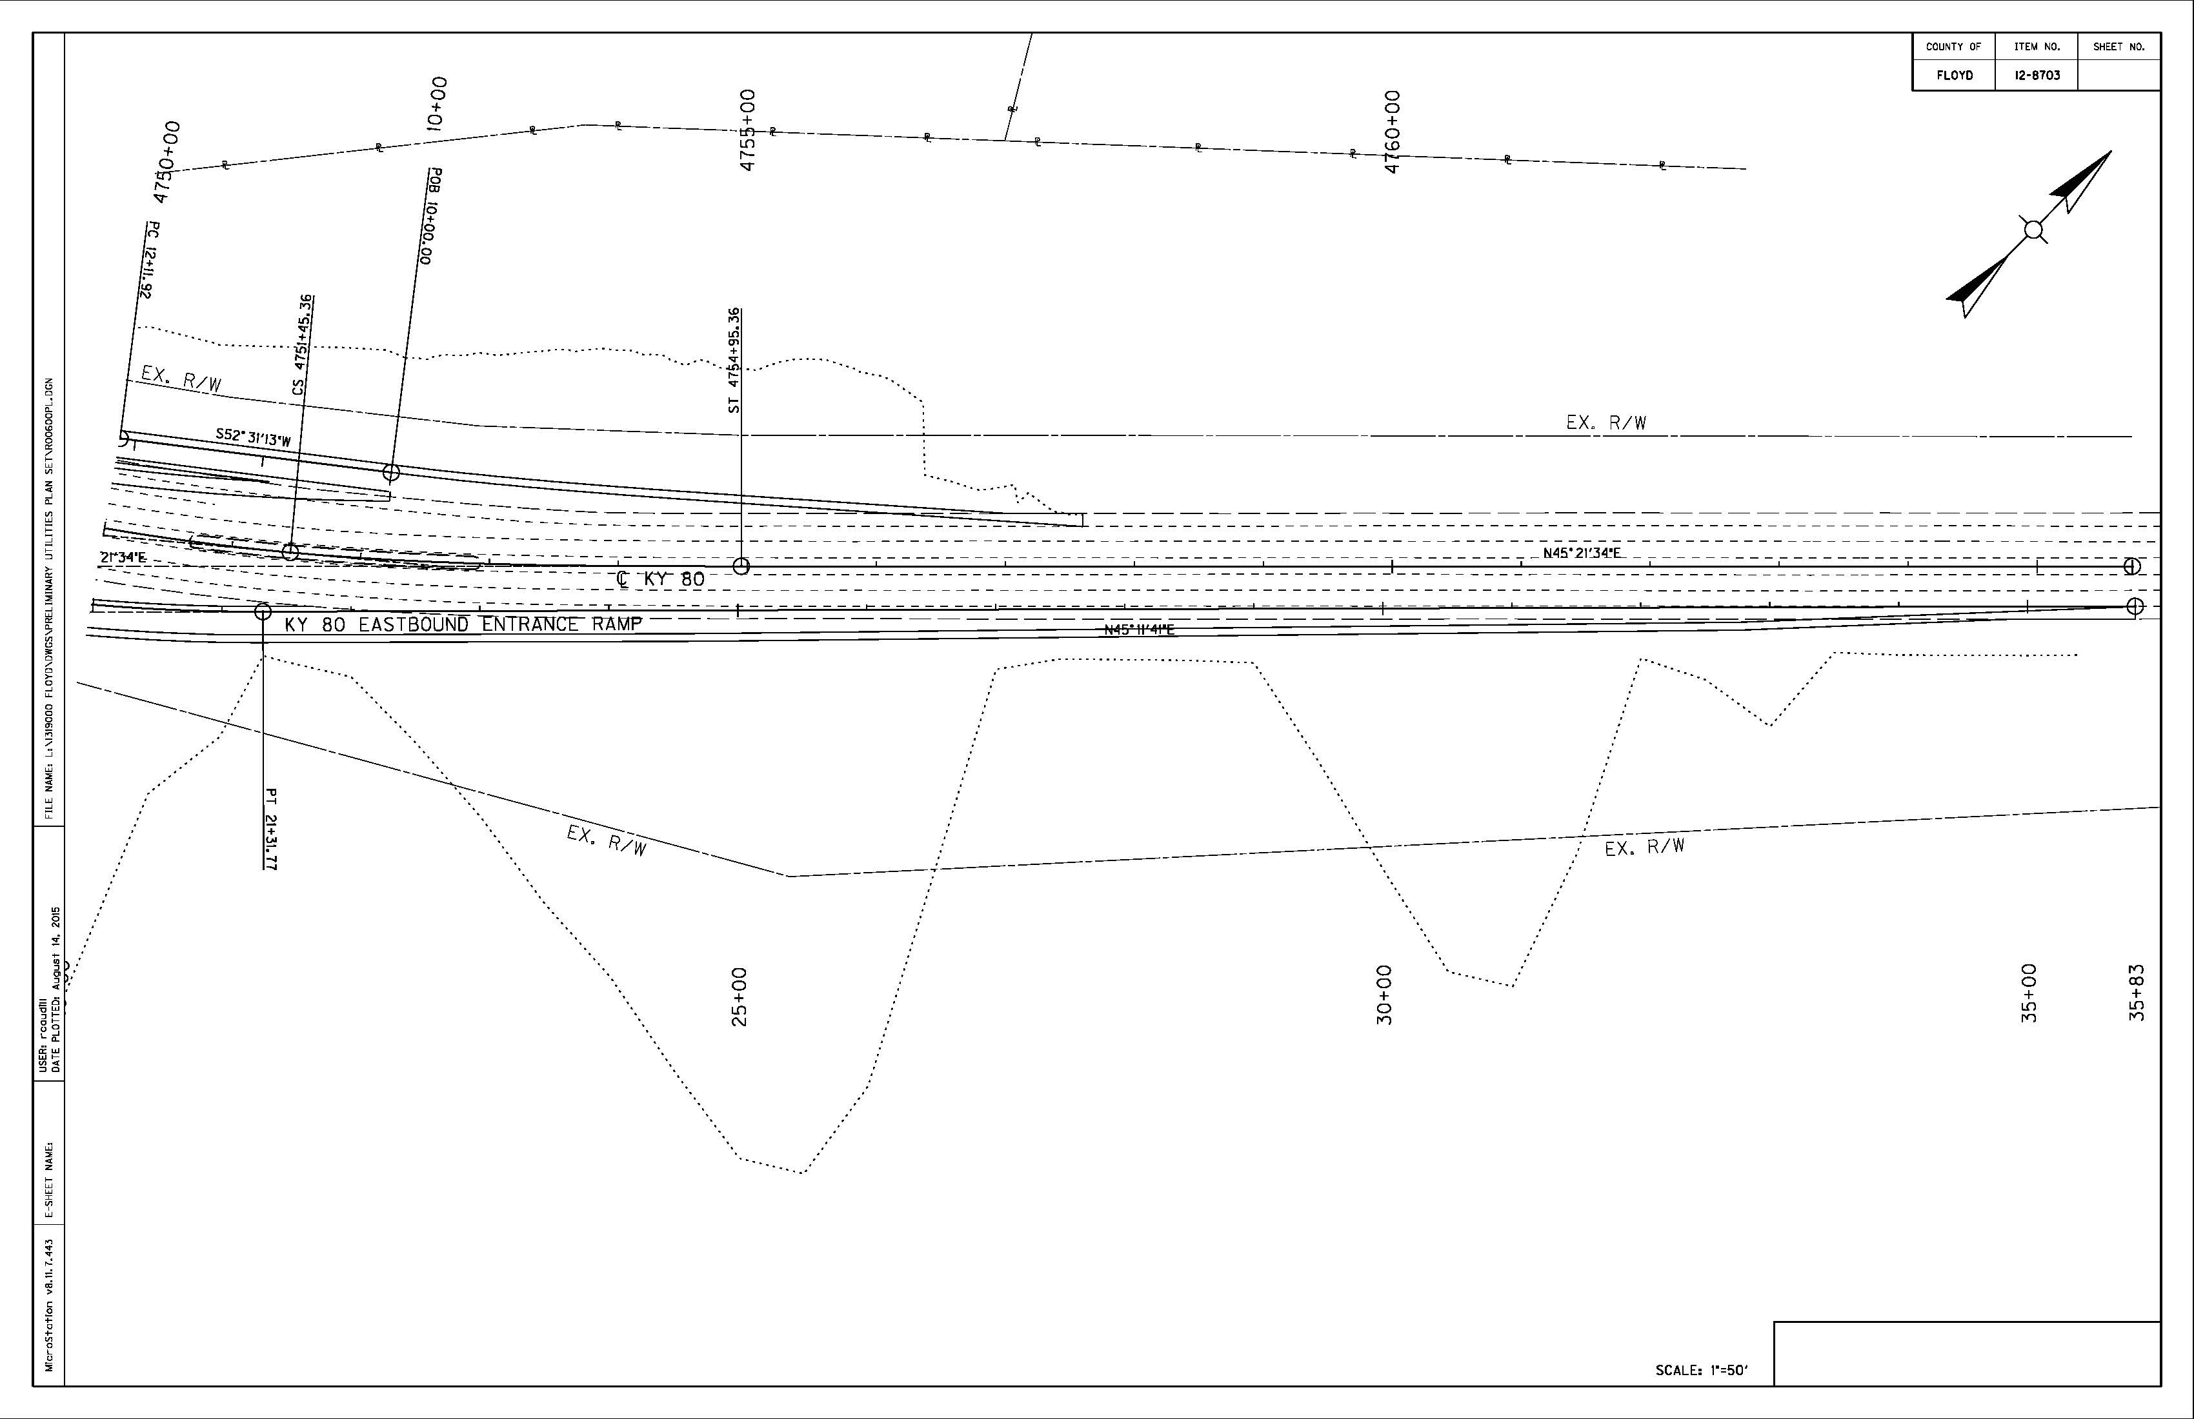
District 12 Utility Coordination Assignment
Floyd County, 12-8703
KY 80 – Improve Access to KY 7 at Garrett

Slide 27
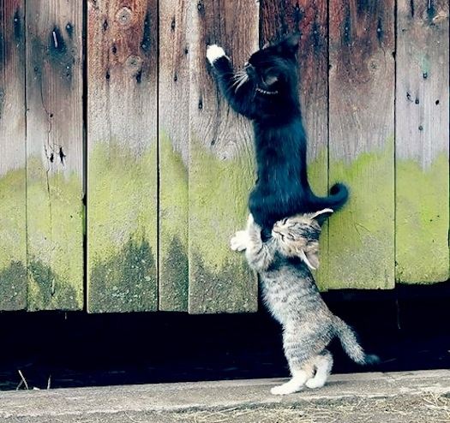
Questions?
Utility Coordination – We Are Happy To Help!

